Slide 1



FISH MARKET ANALYSIS
Machine Learning Approach to PREDICTING FISH WEIGHT.
AI And Data Science Project
GOAL: USING PHYSICAL MEASUREMENTS AND SPECIES TO PREDICT THE WEIGHT OF FISH AND TRANSLATING PREDICTED WEIGHT INTO ESTIMATED PRICE USING SPECIE-SPECIFIC MULTIPLIERS.

Slide 2
📋 Project Overview
Objective
Developing a machine learning model that predicts the weight of fish and using the predicted weight to estimate the price of fish and support business intelligence decisions.
Dataset
Source: fish_market.csv
Features: Species, Length, Height, Width.
Target: Predicting weight of fish and estimated price.
Methodology
Exploratory Data Analysis.
Data Cleaning & Preprocessing.
Feature Engineering.
Model Training & Evaluation.
Pricing simulation and business insight.
Model optimization and visualization.
Models Used:
Logistic Regression, Decision tree regressor & Random forest Regressor.

Slide 3
📊 Dataset Overview
Exploratory Data Analysis.
Species distribution: Perch (56), Bream (35), Roach (20), others
• Strong correlations: Length1–Weight (0.92), Width–Weight (0.88).
• Outliers: Heavy Pike (>1600g), duplicated Bream entries with small length but high weight.
Visualization:
Scatter plots of features vs. weight.
#SCATTERPLOTS- FEATURE vs WEIGHT
features = ['Length1', 'Length2', 'Length3', 'Height', 'Width']
for feature in features:
plt.figure(figsize=(6, 4))
sns.scatterplot(x=df[feature], y=df['Weight'], hue=df['Species'], palette='Set2')
plt.title(f"{feature} vs Weight")
plt.xlabel(feature)
plt.ylabel("Weight")
plt.show()
Correlation heatmap.
Outlier detection filters.
Features Analyzed
Fish characteristics: Species, Length1(vertical length), length2(diagonal length), length3(cross length), height and width.
Price estimation: Using predicted weight of fish and multiplier.
Data Quality Issues
No missing values.
Categorical data requiring encoding- Species.
Feature scales varied- length vs height.
There were outliers present in weight(some fish weighed more than 1600g)
df[df['Weight'] > 1500]
df[(df['Length1'] < 10) & (df['Weight'] > 500)]

Slide 4
🔧 Data Preprocessing Pipeline
1. Feature Engineering
Label encoding for species. Selected six variables.
X = df[['Species_encoded', 'Length1', 'Length2', 'Length3', 'Height', 'Width']]y = df['Weight']
2. Data Split
80% for training the model.
20% for testing the data and evaluating its perfomance.
Stratified sampling maintained
X_train, X_test, y_train, y_test = train_test_split(X, y, test_size=0.2, random_state=42)

Slide 5
🤖 Model Training
Logistic Regression
Type: Baseline linear model.
Assumption: Linear relationship between features and weight.
Interpretability: High.
Complexity: Low.
Performance: Underfit complex patterns.
Random Forest Regressor.
Type:. Ensemble tree-based regression
Assumption: Aggregates multiple tree for stability.
Interpretability: Medium.
Complexity: High.
Performance: Best performance overall. High accuracy and robust predictions.
Decision Tree Regressor
Type: Tree-based Regression.
Assumption: Captures non-linear splits.
Interpretability: Medium(Visualizable).
Complexity: Medium.
Performance: Improved accuracy but prone to overfitting.
Why These Models?
I started with Linear Regression to establish a baseline.
Then I moved to Decision Tree to capture non-linear relationships.
Finally, I selected Random Forest for its superior performance and generalization.

Slide 6
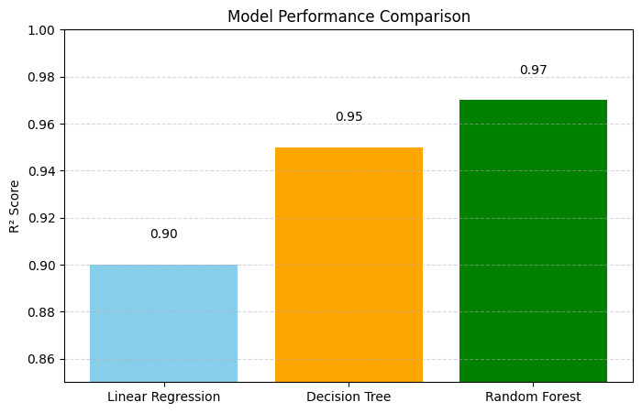
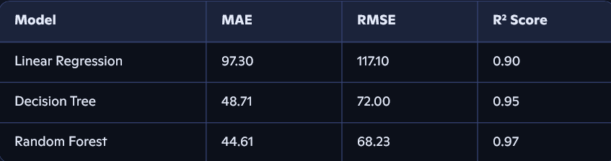
📈 Model Performance Comparison
Encoded species
Selected 6 features
Encoded species
Selected 6 features
Key Finding: Random Forest Regressor delivered the highest predictive performance with an R² score of 0.97, outperforming both Decision Tree (0.95) and Linear Regression (0.90). This confirms it as the most accurate and reliable model for predicting fish weight in this project.
from sklearn.metrics import mean_absolute_error, mean_squared_error, r2_scoreimport numpy as npmae = mean_absolute_error(y_test, y_pred_rf)rmse = np.sqrt(mean_squared_error(y_test, y_pred_rf))r2 = r2_score(y_test, y_pred_rf)print(f"MAE: {mae:.2f}")print(f"RMSE: {rmse:.2f}")print(f"R² Score: {r2:.2f}")

Slide 7

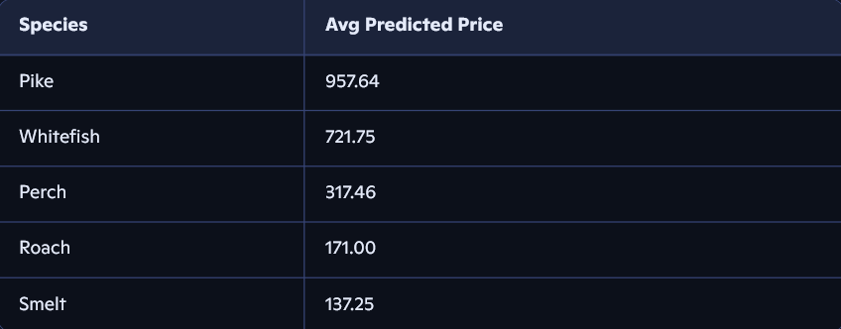
PRICING SIMULATION
Defined species-based multipliers (e.g., Pike: 1.3, Whitefish: 1.5)
Simulated price = predicted weight × multiplier
Analyzed average predicted price per species
Estimated price= predicted weight X species multiplier.
Pike and whitefish are high value.
species_multiplier = { 'Bream': 1.2, 'Roach': 0.8, 'Parkki': 1.0, 'Whitefish': 1.5, 'Perch': 1.1, 'Pike': 1.3, 'Smelt': 0.9}X_test_with_species = X_test.copy()X_test_with_species['Species'] = df.loc[X_test.index, 'Species']X_test_with_species['Multiplier'] = X_test_with_species['Species'].map(species_multiplier)X_test_with_species['Predicted_Weight'] = y_pred_rfX_test_with_species['Predicted_Price'] = X_test_with_species['Predicted_Weight'] * X_test_with_species['Multiplier']

Slide 8
CONCLUSION
• Physical dimensions are strong predictors of fish weight
• Random Forest is the most effective model for this task
• Pricing simulation reveals high-margin species for strategic stocking
• The workflow is reproducible and ready for Business Intelligence integration

